Slide 1
COVID-19 DETECTION ON CT SCANS USING CNN
AMRUTHA MANIKONDA
TEJA CHINTHA
GNANESWARI LOLUGU

Slide 2
Overview of the Problem
COVID-19 is a viral disease that has caused a huge impact on human lives. The daily life of human beings, their health, and the economy of a country are affected due to this disease.
A study of COVID-19 infected patients has shown that these patients are mostly infected from a lung infection after coming in contact with this disease.
Chest x-ray and CT scans are effective imaging techniques for diagnosing lung related issues.
In our work, we have taken the CT scans of COVID-19 affected patients as well as healthy patients.
After cleaning up the images and applying data augmentation, we will use four deep learning-based CNN models and check the accuracies of the performance.
The evaluation of results in terms of training and testing with confusion matrix for the model will be discussed and the best model with highest accuracy will be determined.

Slide 3
Data Description
We have taken our dataset from Github -
https://github.com/UCSD-AI4H/COVID-CT
According to the description in Github, a senior radiologist at Tongji Hospital in Wuhan, China, who has diagnosed and treated a large number of COVID-19 patients during the epidemic of this disease between January and April has validated the usefulness of our dataset.
This dataset has 349 CT scans which are of patients who have been detected with COVID and and 397 CT scans of patients who are perfectly healthy.
So, we will be training our models with a total of 746 images.

Slide 4
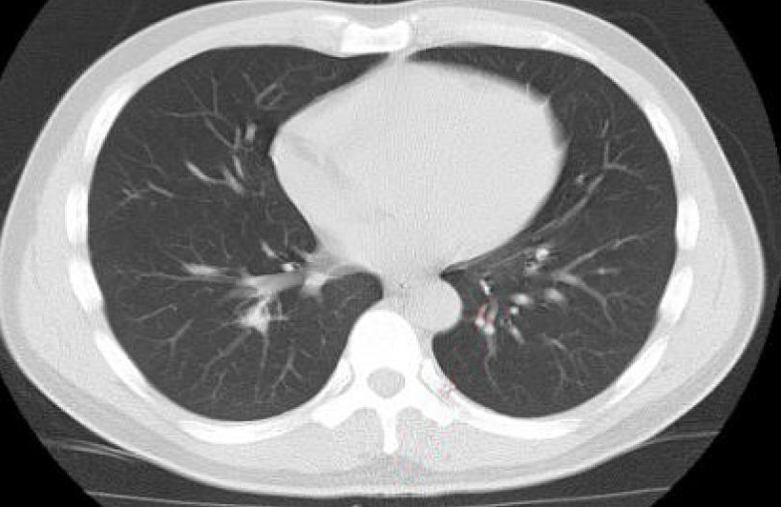
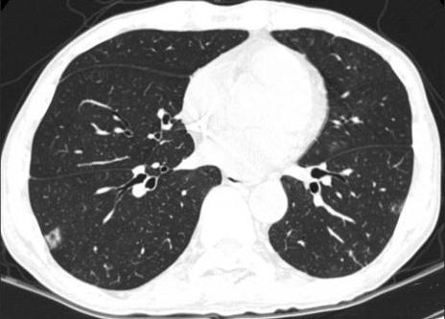
Images of Dataset
CT Scan of a patient with COVID
CT Scan of a healthy patient

Slide 5
Convolutional Neural Network
Convolutional neural network (ConvNets or CNNs) is one of the main categories to do images recognition, images classifications.
A Convolutional Neural Network (ConvNet/CNN) is a Deep Learning algorithm which can take in an input image, assign importance (learnable weights and biases) to various aspects/objects in the image and be able to differentiate one from the other.
The pre-processing required in a ConvNet is much lower as compared to other classification algorithms.
Computers sees an input image as array of pixels and it depends on the image resolution. Based on the image resolution, it will see h x w x d( h = Height, w = Width, d = Dimension ). Eg., An image of 6 x 6 x 3 array of matrix of RGB (3 refers to RGB values) and an image of 4 x 4 x 1 array of matrix of grayscale image.

Slide 6
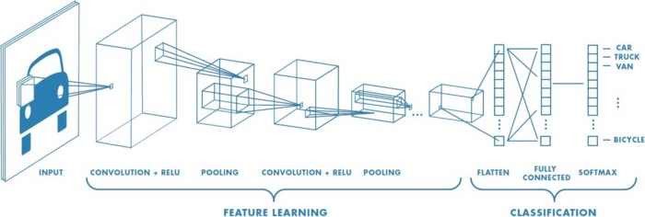
Working of CNN
Deep learning CNN models to train and test, each input image will pass it through a series of convolution layers with filters (Kernels), Pooling, fully connected layers (FC) and apply Softmax function to classify an object with probabilistic values between 0 and 1. The below figure is a complete flow of CNN to process an input image and classifies the objects based on values.

Slide 7
Process (1)
Step 1: Dataset
The dataset of this work was downloaded from a GitHub repository, which contains CT scans of lungs of Covid-19 affected patients and healthy patients. We have a total of 746 images. 80% of the images will be used for training the models and the remaining 20% for testing the accuracy of the models.
Step 2: Building Model
We have built four CNN models, namely: VGG19, ResNet50, InceptionV3 and Xception. We decided to add 3 custom layers (Flatten, Dropout & Dense) to the pre-trained models so that the above mentioned models can be trained well according to our dataset. The images in the dataset are of different sizes.As such, we have resized them to a fixed size of 224 x 224 px before they can be fed to the deep learning models for training.

Slide 8
Process (2)
Step 3 – Training Model
We used Image Data Generator to train the models at modified versions of the images, such as at different angles, flips, rotations or shifts. We trained the model with 500 epochs and 32 images for each batch size.
Step 4 – Making Predictions
Using the test set's photographs as input, the trained models have produced predictions.
Step 5 – Evaluation & Results
Finally, we will demonstrate the classification outcomes and confusion matrices to determine the outcomes. To choose the best model, we will compare the models and plot each model's accuracy.

Slide 9
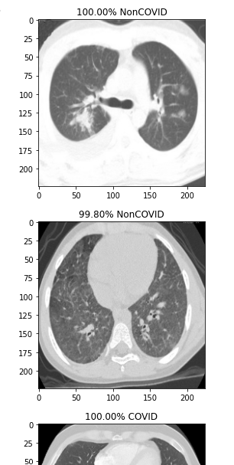
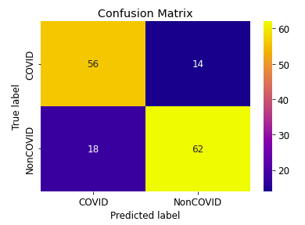
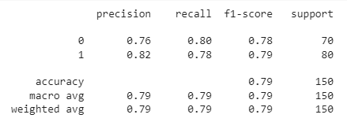
Results of Xception Model
Confusion Matrix
Classification Report
Percentage of Prediction

Slide 10
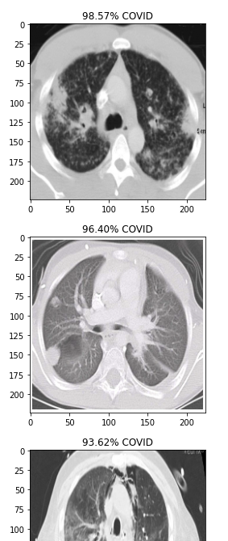
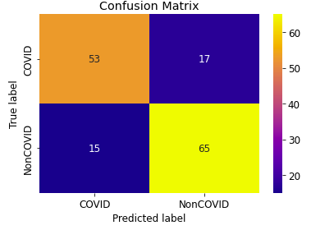
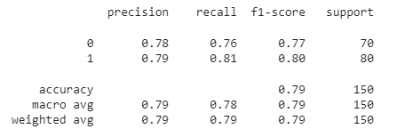
Results of ResNet50 Model
Classification Report
Confusion Matrix
Percentage of Prediction

Slide 11
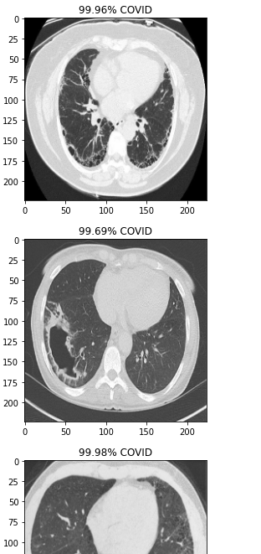
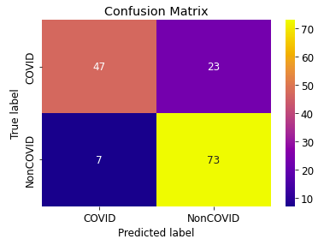
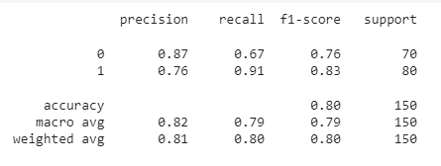
Results of VGG19 Model
Confusion Matrix
Classification Report
Percentage of Prediction

Slide 12
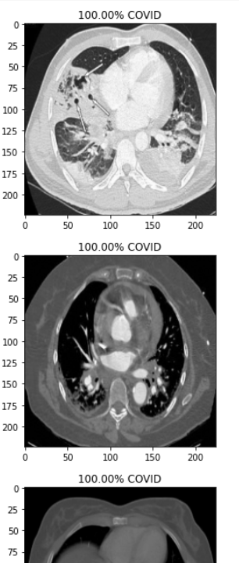
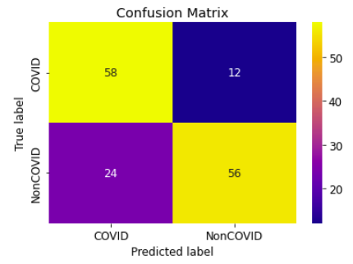
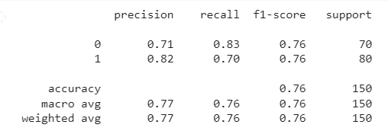
Results of InceptionV3 Model
Confusion Matrix
Classification Report
Percentage of Prediction

Slide 13
Results and What can be Improved?
Out of all four models, VGG19 attained a highest accuracy of 80 %.
And the least accuracy of all was by InceptionV3 which is of 76 %.
ResNet50 and Xception have attained an accuracy of 79 %.
All our four models performed well with the number of epochs, number of images used for training, added custom layers.
But to improved the accuracy further, we can increase the number of epochs and also add more number of images to train the data better before testing it.
We can also plan on adding more custom layers of Conv2D, Dropout, Dense or Flatten to attain better accuracies.

Slide 14
References
https://link.springer.com/article/10.1007/s10489-020-01902-1
https://journals.sagepub.com/doi/full/10.1177/2472630320958376
https://www.hindawi.com/journals/ijbi/2020/8889023/
https://towardsdatascience.com/a-comprehensive-guide-to-convolutional-neural-networks-the-eli5-way-3bd2b1164a53

